Slide 1
Tableau Module 4
Data Analytics

Slide 2



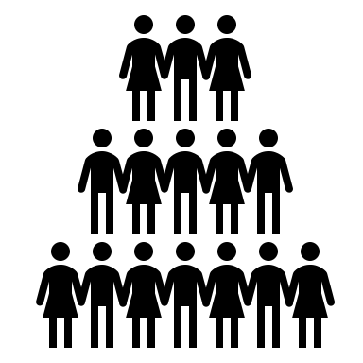






















Common Charts
Data Views
Hierarchies
Data Structures
You are here
Basic Navigation
Dashboards
Data Stories
Calculations
Advanced
Charts
Certification Springs
Blending
Done

Slide 3
Module 4 Learning Outcomes
Understand the parts of the View Pane
Demonstrate using shelves with axes
Understand adding filters
Demonstrate charts with multiple axes

Slide 4
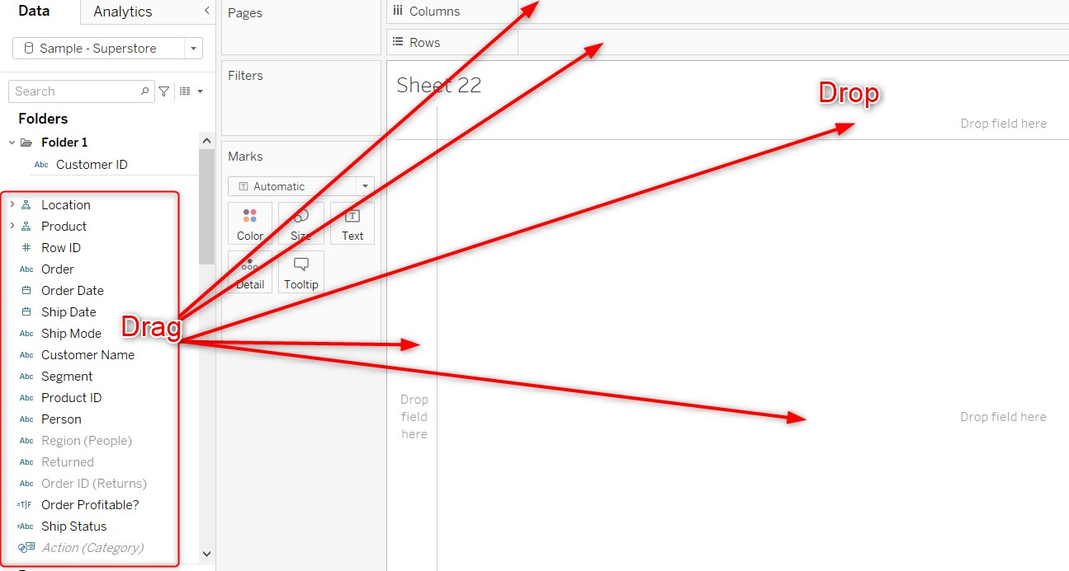
The View Pane

Slide 5
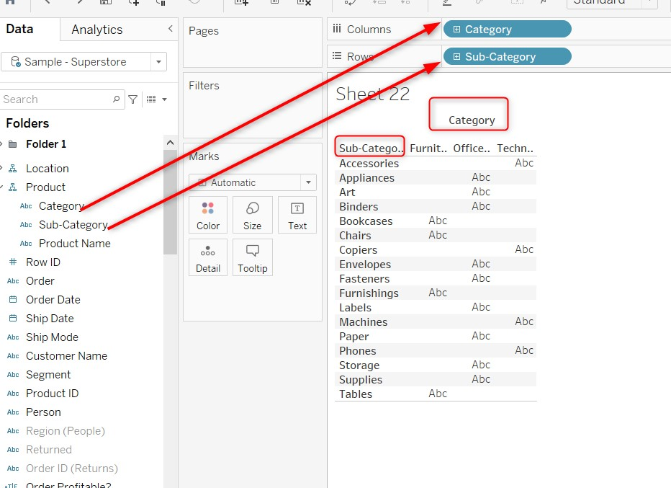
Headers and Axes

Slide 6
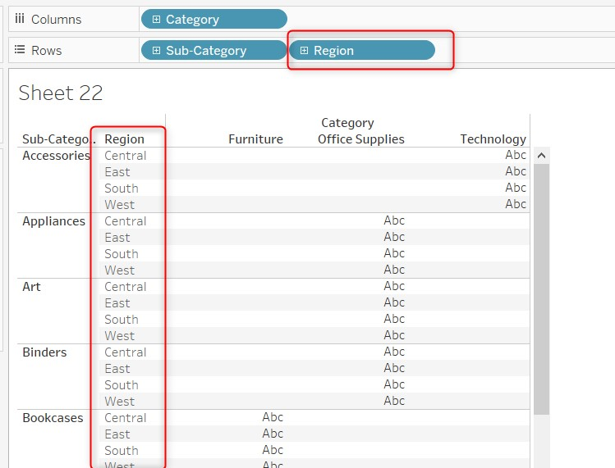
Headers and Axes

Slide 7
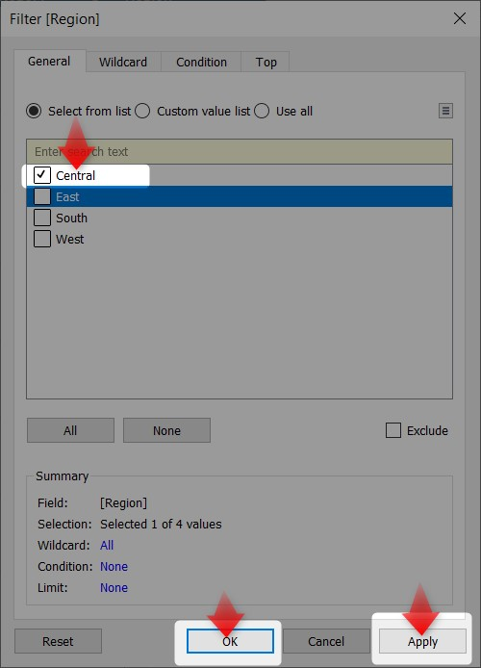
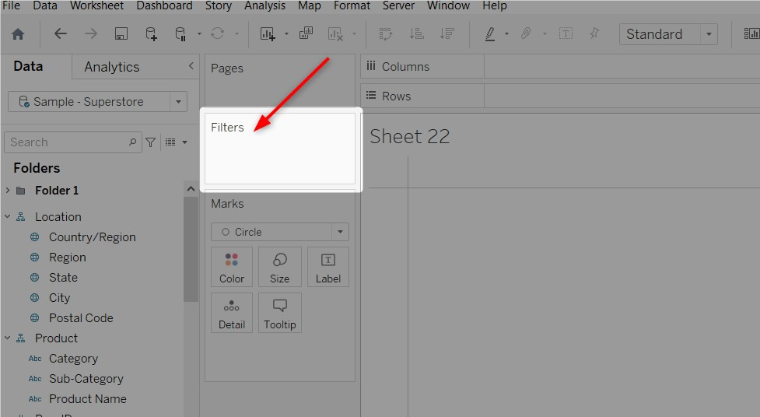
Adding Filters

Slide 8
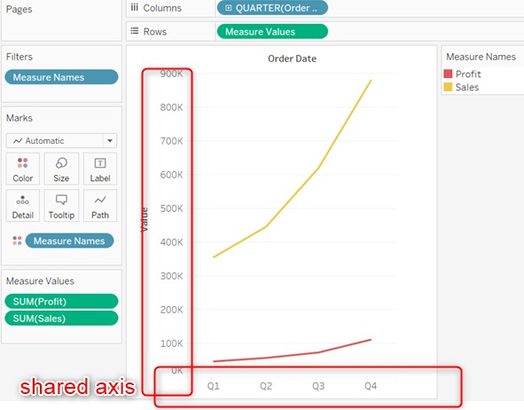
Shared Axis

Slide 9
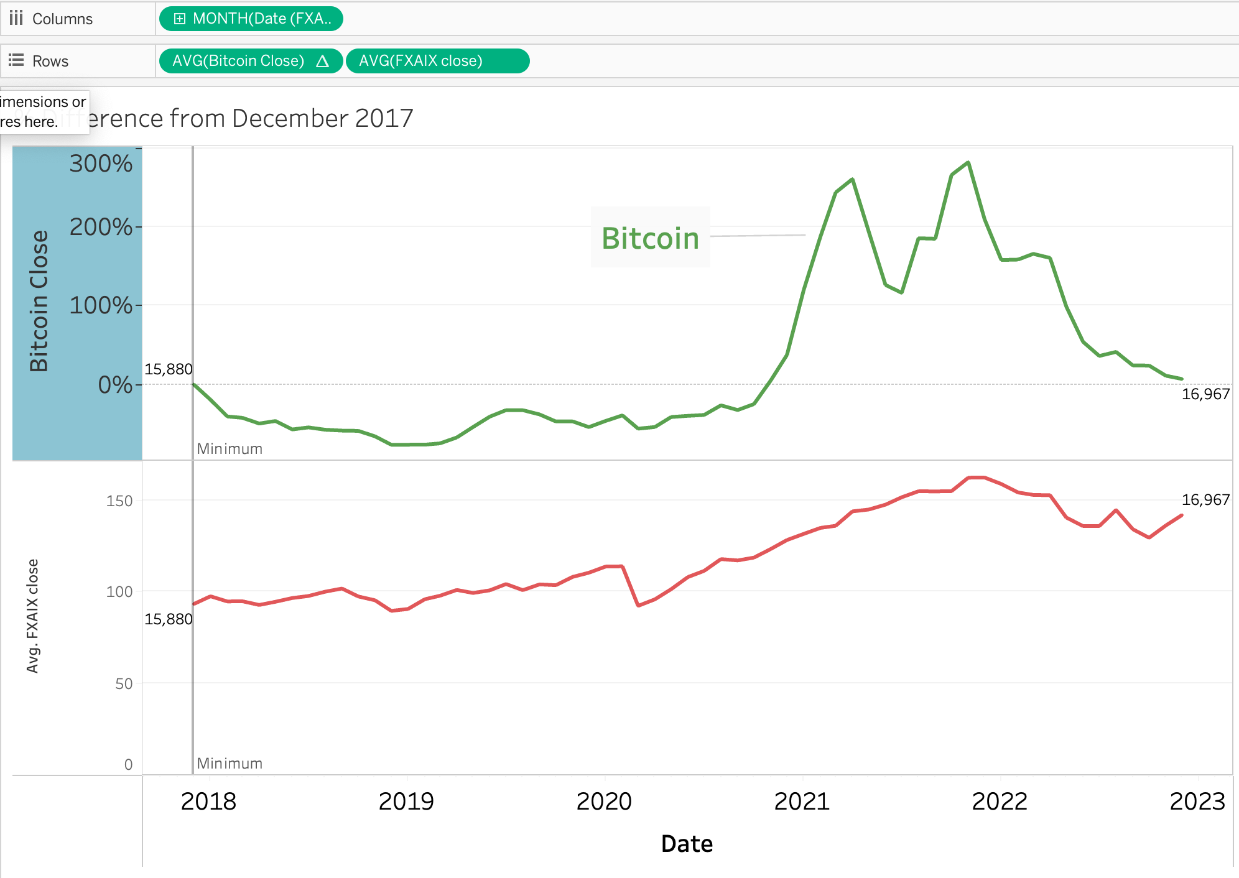
Multiple Axes

